Slide 1
MESSAGE FROM THE 6TH WORLD WATER FORUM
COPING WITH UNCERTAINTIES RELATED TO CLIMATE AND GLOBAL CHANGES
OUTCOME TO ACTION PLAN
FROM MARSEILLES (2012) TO DAEGU (2015)

Slide 2
Growing uncertainty over the future
Climate change is having a profound impact on water resources, as evidenced by changes in snowpack, sea level, river flows, drought, extreme events, runoff in different regions of the world.
Not only climate change, but anthropogenic factors of all kinds including population, the economy, resource use, energy development, transport, communication, land use and cover, urbanization, etc., are increasing uncertainties about future water availability for human needs.
Those impacts are raising a range of new challenges for water resources managers to deal with uncertainty in water resources planning and management.
Carter & Parker, HSJ, 2009

Slide 3
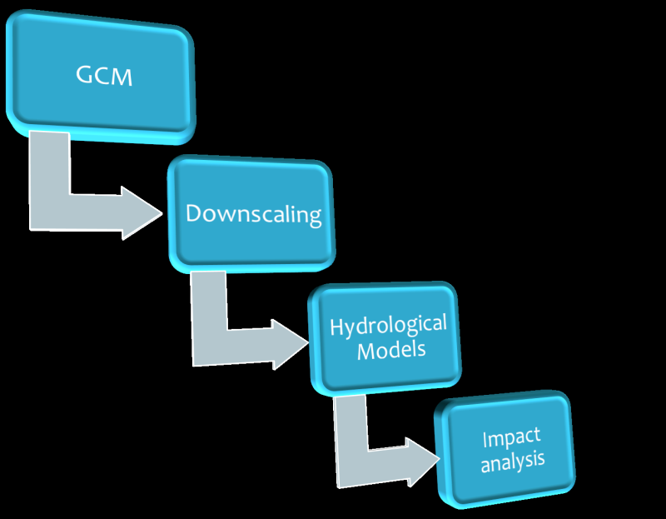
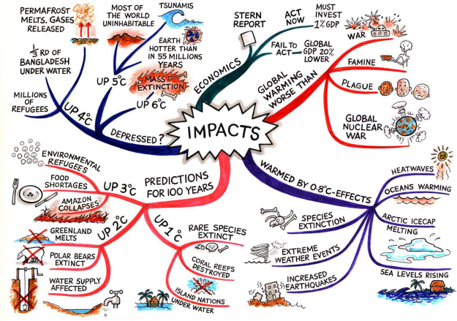
A complex environment for decision making
The entire modelling chain is affected by uncertainty, which creates a very complex environment for policy making
Di Baldassarre et al., IAHS Hydrological Sciences Journal, 2011
Rob Swart, CIRCLE-2, 2010

Slide 4
Coping with uncertainties related to climate and global changes: Developing new tools and methodologies for water planning and management
UNESCO, November 2011 / 6th World Water Forum, March 2012 / Rio+20, June 2012 / 7th World Water Forum, 2015
An group of river basin managers and scientists from various places of the world came together, under the coordination of the French Water Academy and UNESCO, with a view to improve dialogue between the scientific community and managers and develop new tools and methodologies for water planning and management.
Reduce the field of uncertainties by improving scientific models and tackling a wider range of issues (increase precision, encompass …);
Integrate uncertainties in short and long term predictions for surface and groundwater systems and develop tools and methodologies for robust planning.

Slide 5
4 key recommendations
1/ By 2013: compile a scientific review and synthesis on the impacts of climate change on groundwater resources including management recommendations and bring it to the attention of IPCC authors as a contribution to the on-going preparation of the 5th Assessment Report.
Leaders: UNESCO-IHP (GRAPHIC project) and the International Association of Hydrogeologists (IAH)
2/ By 2012: initiate a networking platform for researchers and water managers as a water science-policy interface in order to facilitate communications in relation with the IPCC and other UN conventions, and to provide relevant inputs to help water resources managers develop effective management and climate change adaptation strategies.
Leaders: UNESCO-IHP, ONEMA

Slide 6
4 key recommendations (2)
3/ By 2012: provide a networking platform of basin organizations for the collection and exchange of best practices and experiences on the implementation of climate change adaptation strategies in the field of water resources planning and management, relying on existing initiatives of UNECE and INBO and involving regional and international programmes.
Leaders: INBO, UNECE
4/ By 2015: develop methodological guidelines based on gathered information and lessons learned from both networks, to promote the creation of new tools of governance for decision-makers to better integrate climate change impacts into water resources planning and management.
Leader: French Water Academy

Slide 7
Roadmap to action
Marseilles: 40 science-based and policy-oriented “solutions”
Links with the Water and Climate Coalition to get closer to the UNFCCC processes.
Commitments to lead the 4 key recommendations: INBO, UNECE, ONEMA, WMO, the GEF, Météo France, basin organizations and research institutes from the 5 continents.
Follow-up: Launch of the Taskforce on July 2nd
Next steps:
Workshop on water to be held in Mexico by the SBSTA from July 23 to 25, 2012
Presentation of progress at the 7th World Water Forum (Daegu, Korea, 2015)

Slide 8
Join the group!
Contacts:
a.mishra@unesco.org
jeanluc.redaud@numericable.fr
boissonnet.amelie@aesn.fr
Thank you

